Slide 1
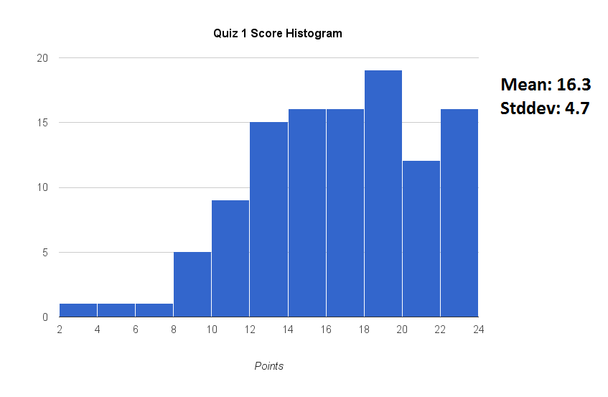

First exam
Solution keys posted on Mastering Physics:

Slide 2
Chapter 5 Energy

Slide 3

Chapter 5 Preview
Looking Ahead: Kinetic Energy
The energy of an object associated with its motion is called kinetic energy.
You will learn that the kinetic energy is a scalar quantity and is independent of the direction of motion.

Slide 4
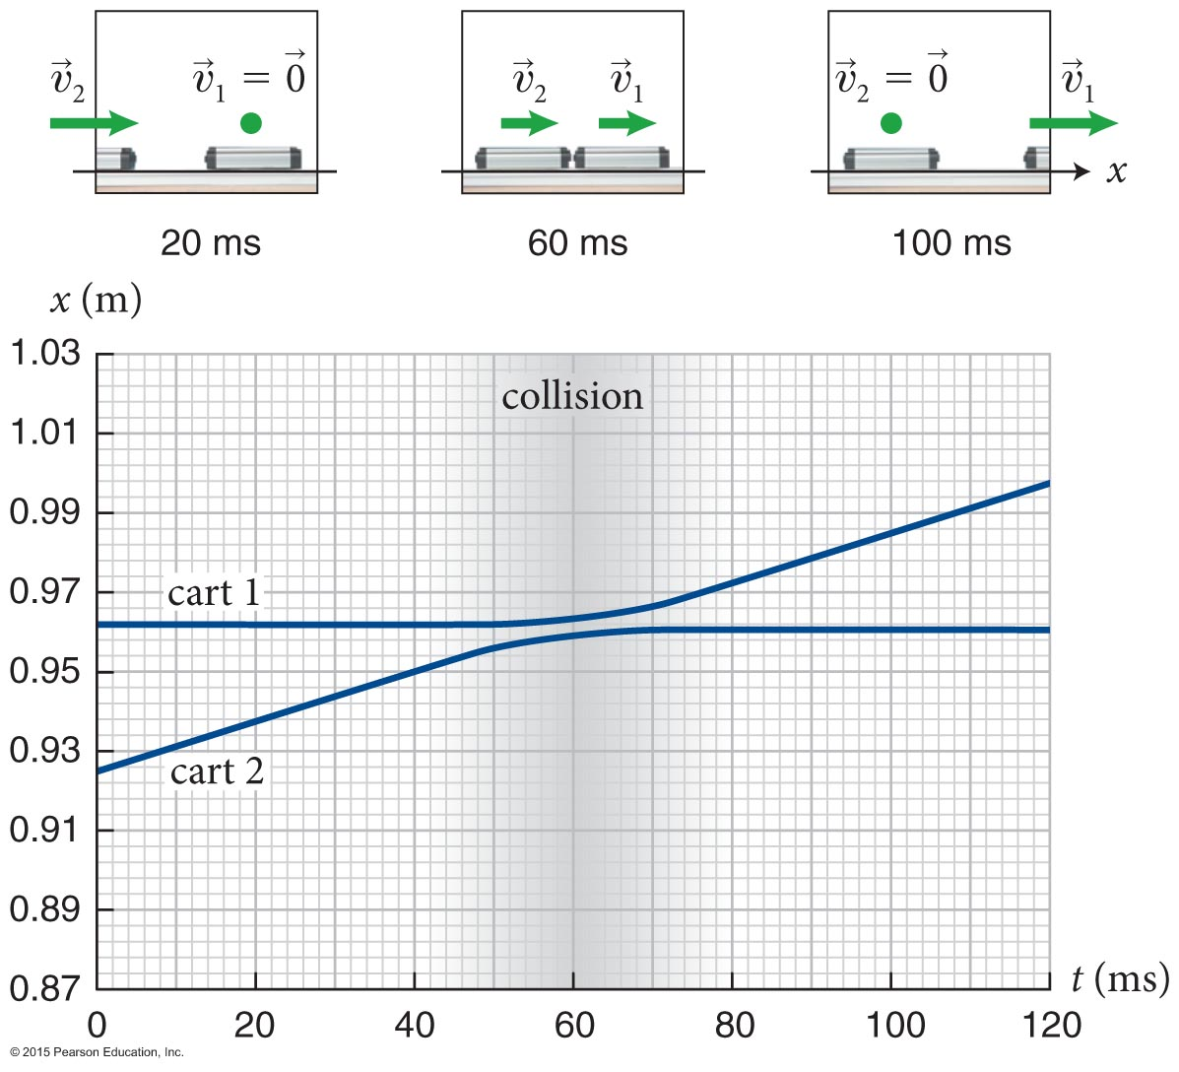
Chapter 5 Preview
Looking Back: Momentum
The ability of an object to affect the motion of other objects in a collision is quantified by a concept called momentum.
Momentum depends on an object’s amount of matter (inertia) and how fast it is moving (velocity).
You learned how to calculate momentum for individual objects and systems of interacting objects.

Slide 5
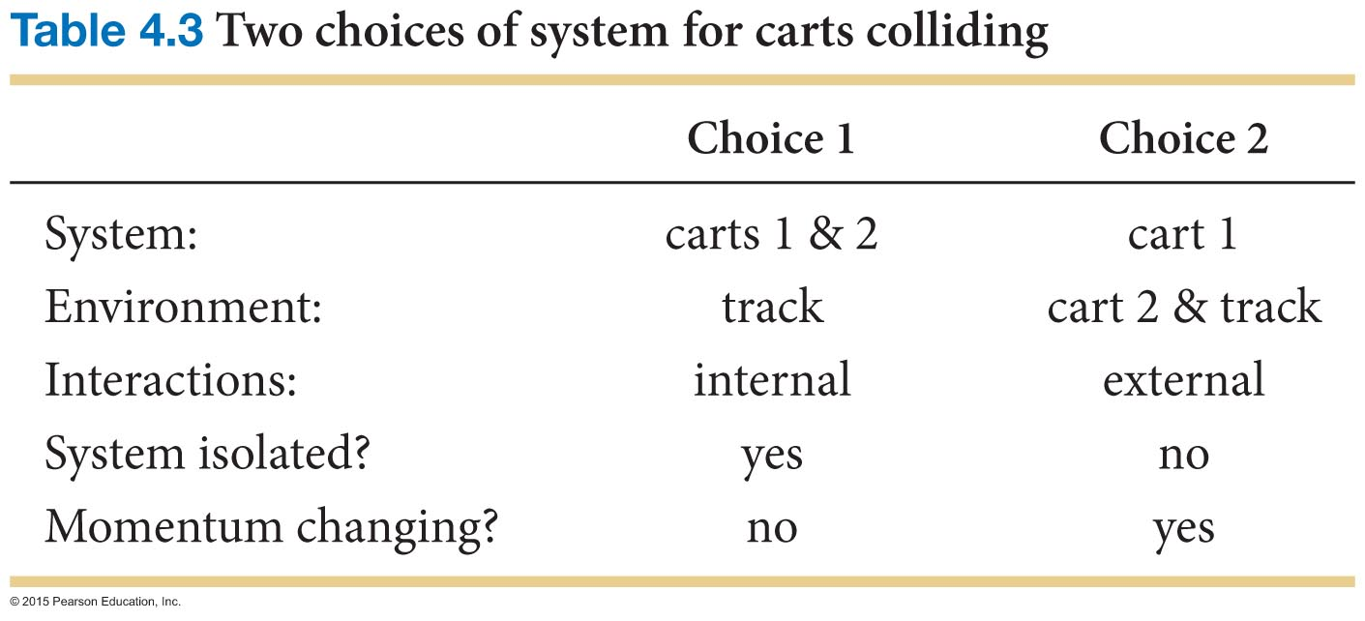
Chapter 5 Preview
Looking Back: Conservation of Momentum
For isolated systems (that have no external influences), the momentum of the system obeys an important general principle.
The momentum of an isolated system does not change: Momentum is conserved.
You learned how to apply the conservation of momentum in order to predict the kinematics of interacting objects.

Slide 6
Section Goal
Section 5.1: Classification of collisions
You will learn to
Classify the types of collisions depending on the relative velocity of the colliding objects.

Slide 7
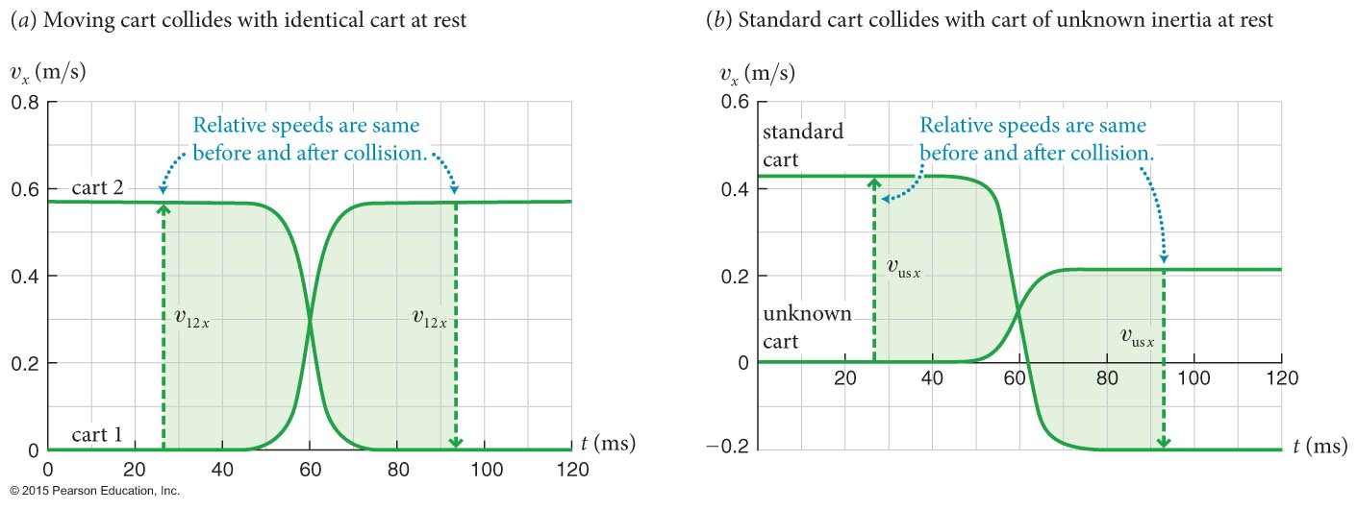
Section 5.1: Classification of collisions
The figure 5.1 shows the υ_{x}(t) curves for two carts colliding.
  Notice that the velocity differences before and after collisions are highlighted.
Relative velocity of the carts:
is the velocity of cart 2 relative to cart 1.
Relative speed of the carts:
is the speed of cart 2 relative to cart 1.

Slide 8
Checkpoint 5.1
Two cars are moving along a highway with neither one accelerating. Is their relative speed equal to the difference between their speeds? Why or why not?
5.1
+5 m/s
+10 m/s
relative speed = 5 m/s
difference between their speeds?
-5 m/s
+10 m/s
relative speed = 15 m/s
difference between their velocities?

Slide 9
Section 5.1: Classification of collisions
Elastic collision: A collision in which the relative speeds before and after the collision are the same.
Inelastic collision: A collision in which the relative speed after the collision is lower than before the collision.
Totally inelastic collision: A special type of inelastic collision in which the two objects move together after the collision so that their relative speed is reduced to zero.

Slide 10
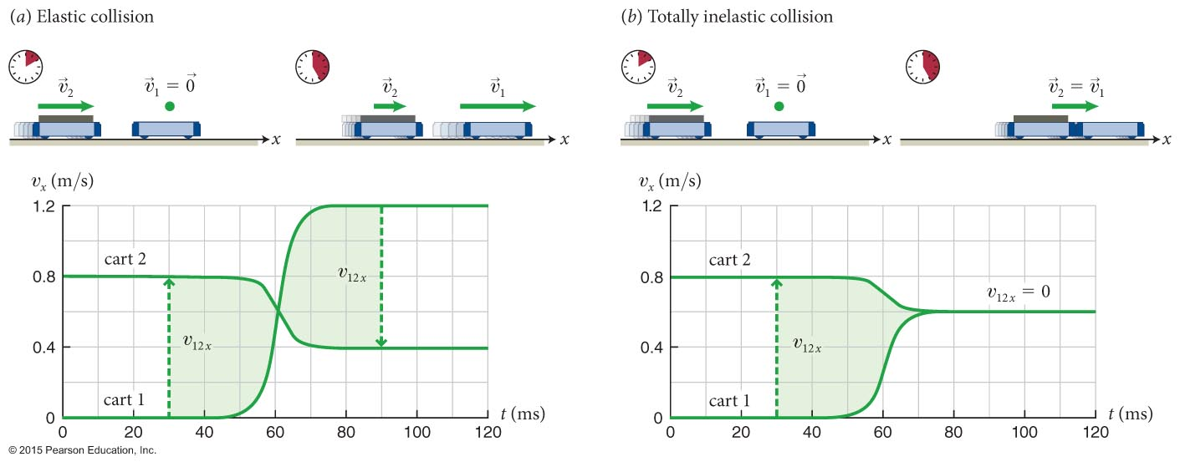
Section 5.2: Kinetic energy
The quantity, K = (1/2)mυ² is called kinetic energy of the object, that is, “energy” associated with motion.
Let us calculate the kinetic energy of the carts before and after the collisions (elastic collision and a totally inelastic collision) shown in the figure.

Slide 11
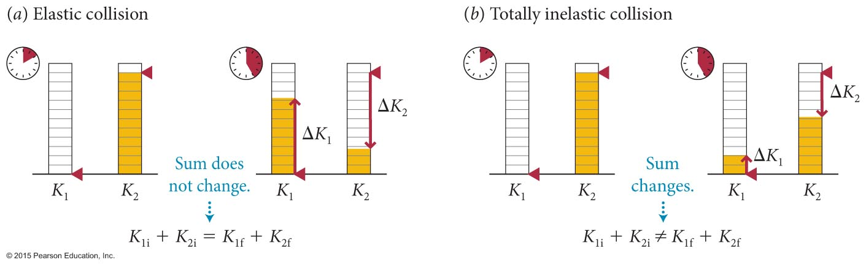
Section 5.2: Kinetic energy
Because kinetic energy is a scalar extensive quantity, bar diagrams are a good way to visually represent changes in this quantity.
The figure below shows collisions seen in the previous slides.

Slide 12
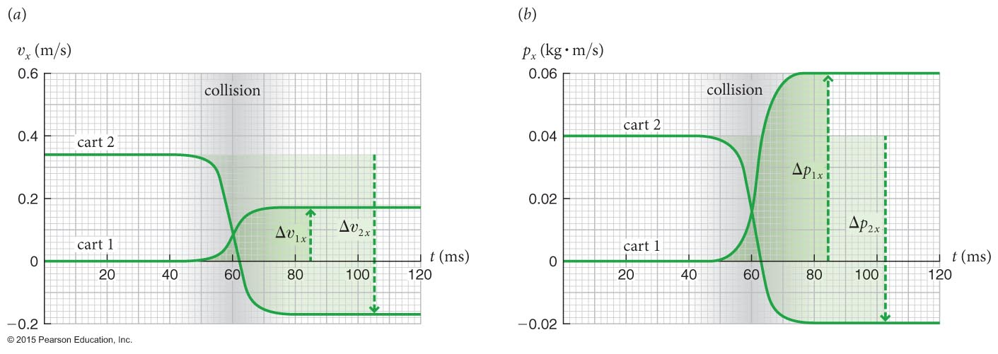
Example 5.2 Carts colliding
Section 5.2: Kinetic energy
(a) Is the collision in Figure 4.23 elastic, inelastic, or totally inelastic?
How can you tell?
2
1
initial
+0.34 m/s
0.12 kg
0.36 kg
momentum conserved
-0.17 m/s
+0.17 m/s
0.12 kg
0.36 kg
final

Slide 13
Section 5.3: Internal energy
In all inelastic collisions, the relative speed changes and therefore the total kinetic energy of the system changes.
What happens to this energy?
  Does it just appear from nowhere or simply vanish?
  Let us answer this question by looking at inelastic collisions.
The state of a system is the condition of an object completely specified by a set of parameters such as shape and temperature.
The transformation of a system from an initial state to a final state is called a process.

Slide 14
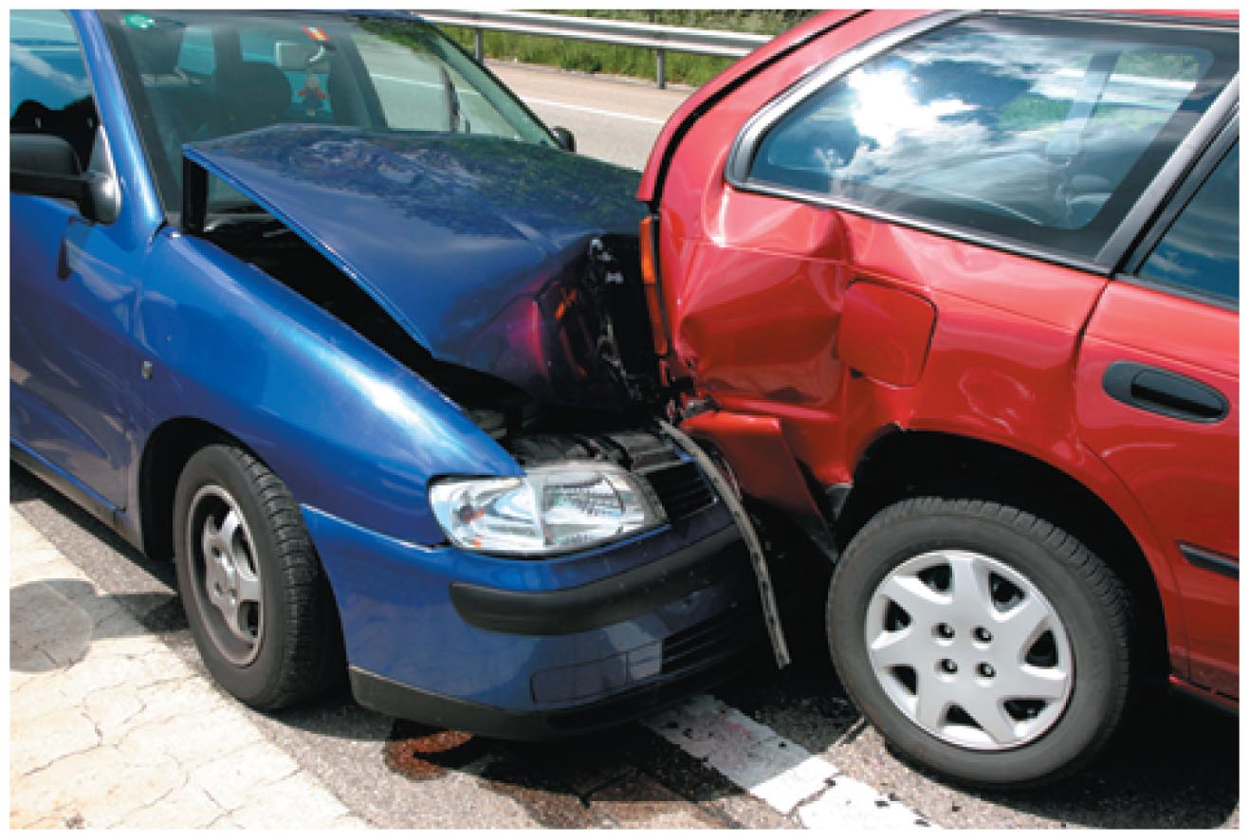
Section 5.3: Internal energy
Inelastic collisions are irreversible processes: The changes that occur in the state of the colliding objects cannot spontaneously undo themselves.

Slide 15
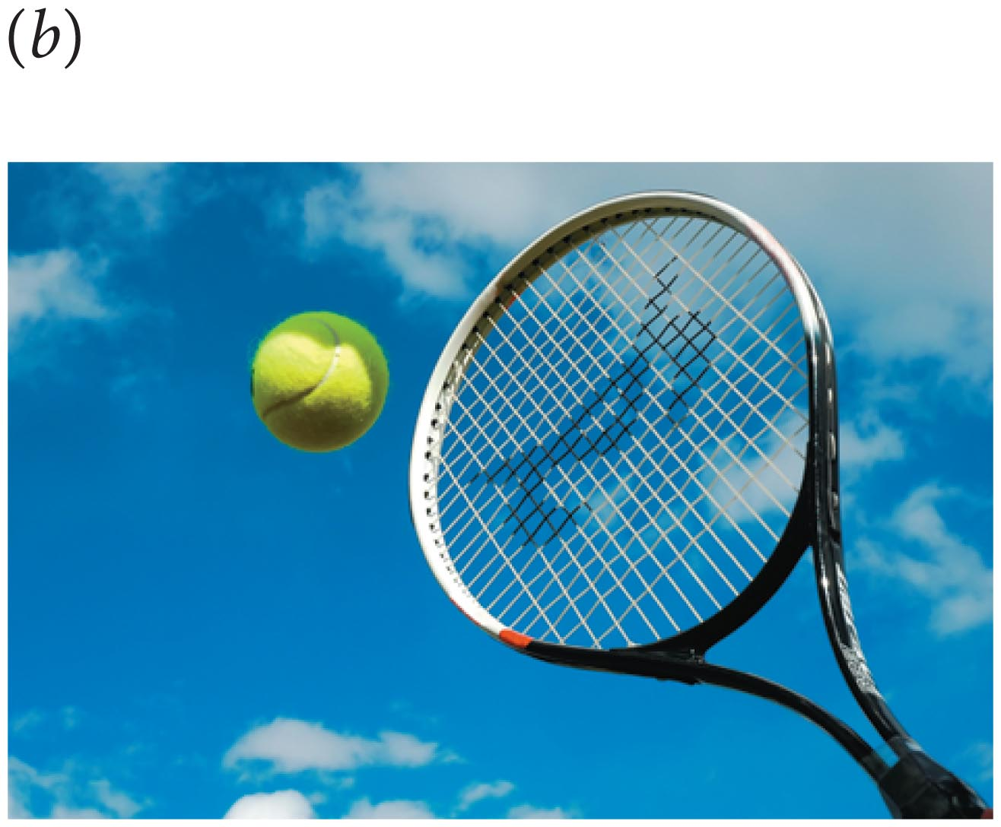
Section 5.3: Internal energy
Elastic collisions are reversible processes: There are no permanent changes in the state of the colliding.

Slide 16
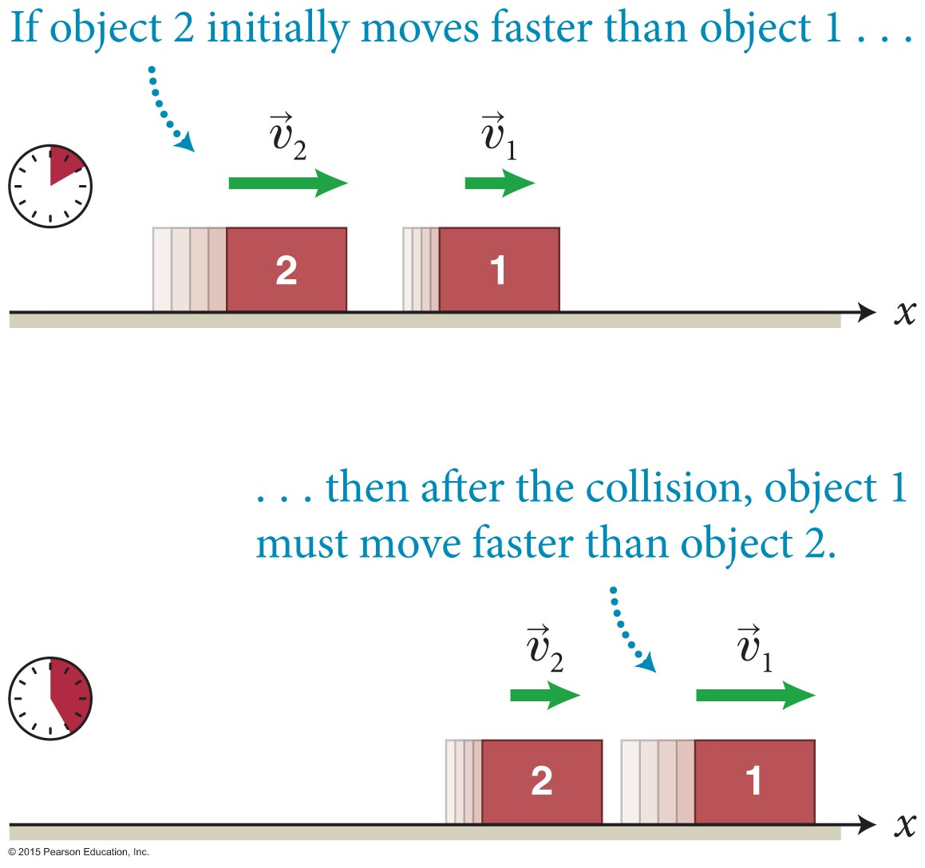
Section 5.5: Elastic collisions
Consider two objects colliding as shown in figure below.
Relative velocity of cart 2 relative to cart 1 is
For elastic collisions, relative speeds before and after the collision are the same:

Slide 17
Section 5.5: Elastic collisions
For two objects moving along the x axis, we can write the previous equation as
Considering the two colliding carts to be an isolated system, the law of conservation of momentum gives us
Algebraic manipulation of the above equations will yield

Slide 18
Section 5.5: Elastic collisions
The definition of kinetic energy is
Now, we can rewrite Eq. 5.11 as
Therefore, for a system of objects undergoing an elastic collision,
The SI unit for kinetic energy is kg · m/s².
We give this combination of units the name joule:

Slide 19
Chapter 5 Energy

Slide 20
Section 5.5: Elastic collisions
Consider two objects colliding as shown in figure below.
Relative velocity of cart 2 relative to cart 1 is
For elastic collisions, relative speeds before and after the collision are the same:

Slide 21
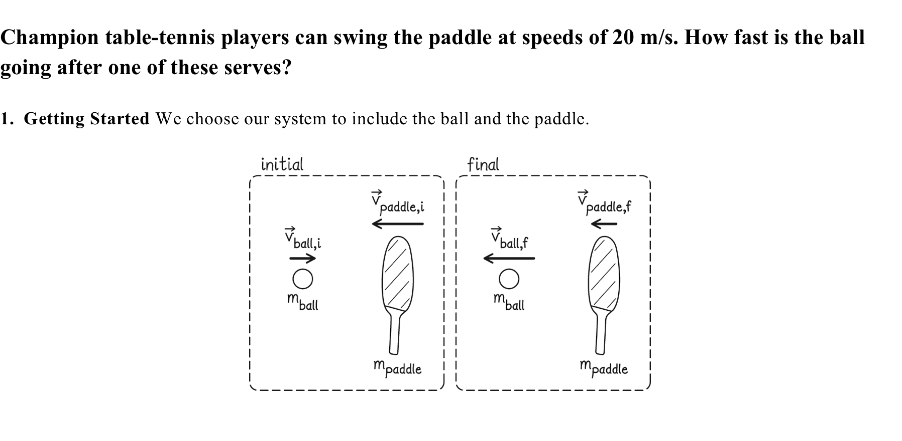
Section 5.5: Elastic collisions

Slide 22
Section 5.5: Elastic collisions
Any system to or from which no energy is transferred is called a closed system.
A system for which there are no external interactions is said to be isolated:
  For such systems,
Will approximate as isolated and closed.
If contact time is short, no momentum is transferred from hand to paddle to ball.
Ignore sound waves, therefore energy doesn’t leave system

Slide 23
Section 5.5: Elastic collisions
assume ball velocity zero initially
assume mass of paddle
much greater than ball,
therefore
the paddle will not slow down

Slide 24
Section 5.5: Elastic collisions

Slide 25
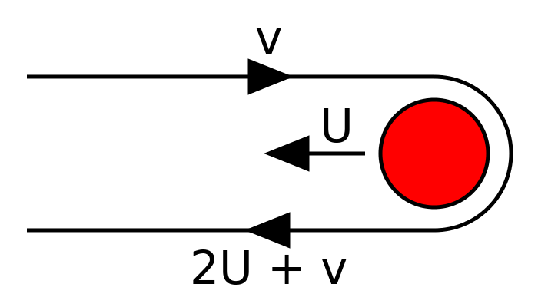
Section 5.5: Elastic collisions
https://www.youtube.com/watch?v=sYp5p2oL51g
https://www.youtube.com/watch?v=kZS4UsOHmLE
http://demonstrations.wolfram.com/GravitationalSlingshotEffect/
http://www.universetoday.com/113488/how-do-gravitational-slingshots-work/

Slide 26
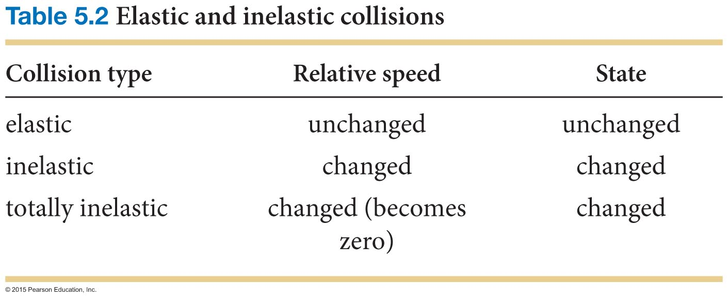
Section 5.3: Internal energy
Notice in the table below how the change in total kinetic energy goes hand in hand with a change in the state.
To explore this connection further let us introduce a new quantity called internal energy:
  In an inelastic collision one form of energy is converted to another form of energy (kinetic to internal).
  The sum of kinetic and internal energy remains constant.

Slide 27
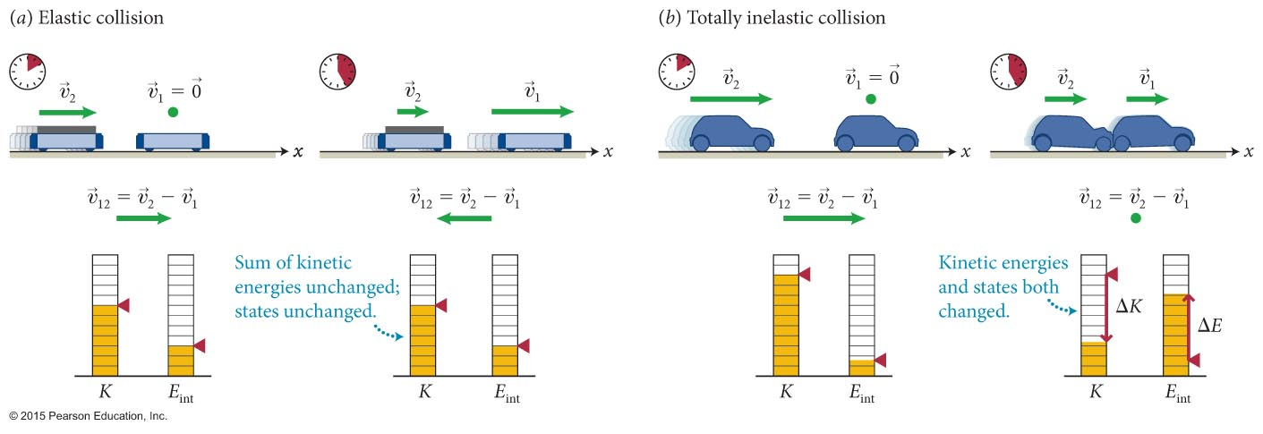
Section 5.3: Internal energy
Now we can make the following statements about collisions:
  Inelastic collision: The states of the colliding objects change, and the sum of their internal energies increases by an amount equal to the decrease in the sum of their kinetic energies.
  Any collision: The energy of a system of two colliding objects does not change during the collision.

Slide 28
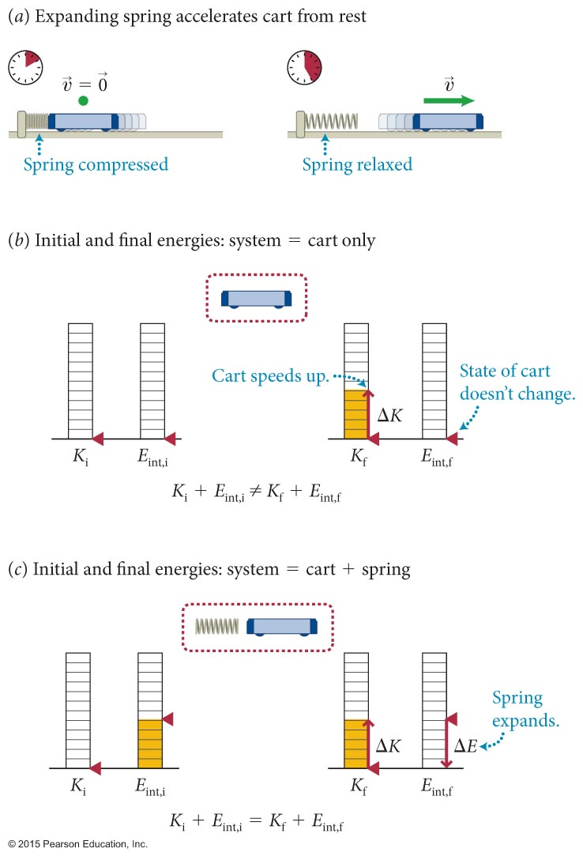
Section 5.3: Internal energy
We can now extend the idea of internal energy to other interactions, and from these observations we can make the following assertion:
Energy can be transferred from one object to another or converted from one form to another, but energy cannot be destroyed or created.
No observation has ever been found to violate this statement known as the law of conservation of energy.

Slide 29
Checkpoint 5.7
(a) Is the momentum of the cart-spring system in Figure 5.8 constant? (b) Is the system isolated? (c) Is the energy of the system constant? (d) Is the system closed?
5.7
not isolated
not closed
not isolated
closed

Slide 30
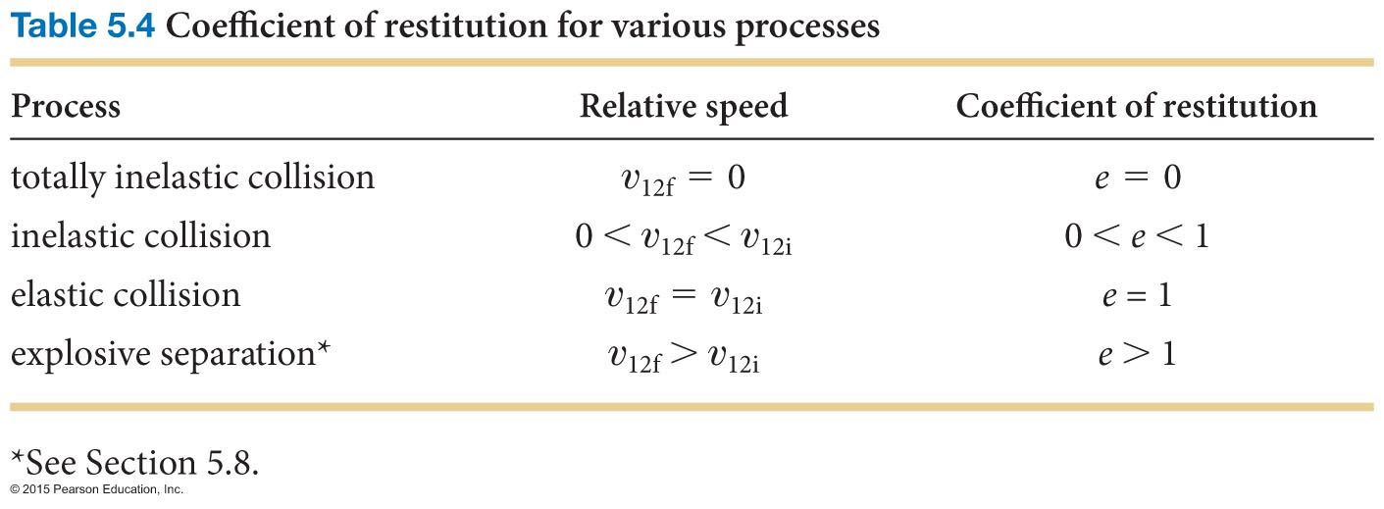
Section 5.6: Inelastic collisions
In totally inelastic collisions, the objects move together after the collision. Therefore,
υ_{12f} = 0 (totally inelastic collision)
Most collisions fall between the two extremes of elastic and totally inelastic.

Slide 31
Section 5.6: Inelastic collisions
For these cases, it is convenient to define the quantity called the coefficient of restitution as
In component form,

Slide 32
Section 5.7: Conservation of energy
For a closed system, conservation of energy requires that
K_{i} + E_{int,i} = K_{f} + E_{int,f} (closed system)
The energy of the system is given by
E ≡ K + E_{int}
Now we can rewrite the first equation as
E_{i} = E_{f} (closed system)
Even though we cannot yet calculate E_{int}, the previous equation allows us to compute ΔE_{int}
ΔE_{int} = –ΔK (closed system)

Slide 33
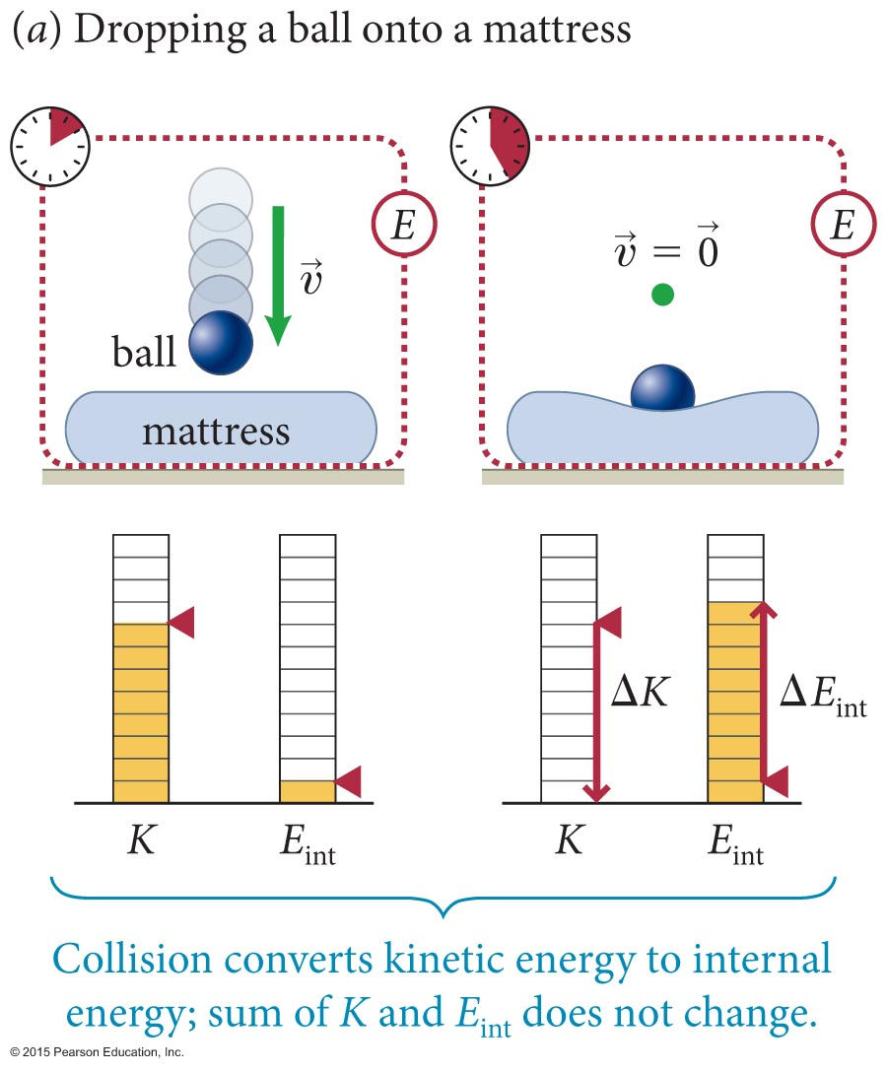
Section 5.7: Conservation of energy
As an example, consider the situation in the figure below, where a ball is dropped onto a mattress:
  Energy conservation requires the loss of kinetic energy to be equal to the gain in internal energy.

Slide 34
Section 5.6
Clicker Question

Slide 35
Chapter 5 Energy

Slide 36
Section 5.6
Clicker Question
ΔP₁ = -ΔP₂
P₁= mv
P₁= 0
ΔP₁=mv
P₁= mv
P₁= -mv
ΔP₁=2mv

Slide 37
Section 5.6
Clicker Question
I.
II.
✔
III.
ΔE_{int} = –ΔK
(closed system)

Slide 38
Section 5.6
Clicker Question
… consider a massive ball of inertial mass M moving at speed v and striking a small ball of inertial mass m initially at rest. The change in the small ball's momentum is
relative velocity: v_{i} – (-U) = v_{i}+U
relative speed: v
_{i}
v
M
v_{f}
relative speed: v
relative velocity: -v_{f} – (-U) = -(v_{i}+U)
2v
v
M
relative velocity: v_{f} = v_{i}+2U
velocity change
Δv = (v_{i}+2U) –v_{i} = 2U
same as slingshot

Slide 39
Section 5.6
Clicker Question
A cart moving at speed v collides with an identical stationary cart on an air track, and the two stick together after the collision. What is their velocity after colliding?
^{v}

Slide 40
Section 5.6
Clicker Question
A cart on an air track is moving at 0.5 m/s when the air is suddenly turned off. The cart comes to rest after traveling 1 m. The experiment is repeated, but now the cart is moving at 1 m/s when the air is turned off. How far does the cart travel before coming to rest?
1m
0.5 m/s
0 m/s
ΔKE = friction energy
1m travelled
?m
4m travelled
1.0 m/s
0 m/s
ΔKE = friction energy

Slide 41
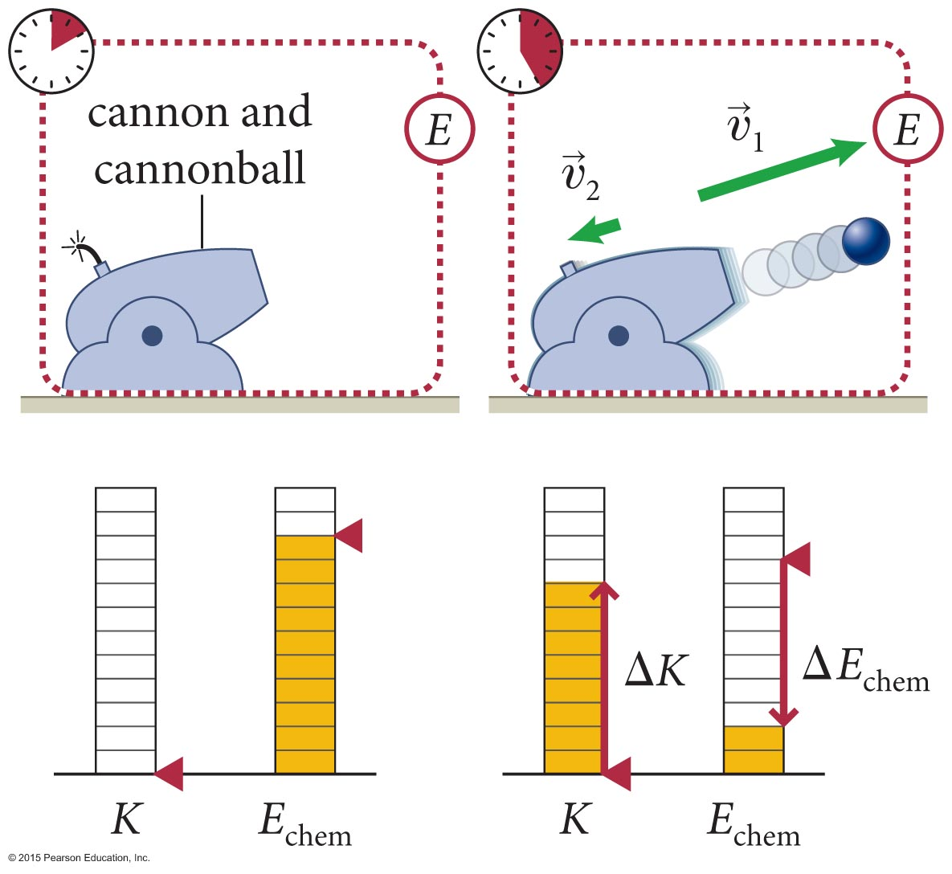
Section 5.8: Explosive separations
Is it possible to have a process in which kinetic energy is gained at the expense of internal energy?
  Yes, in any type of explosive separation, where the object breaks apart. Firing a cannon is one such example.

Slide 42
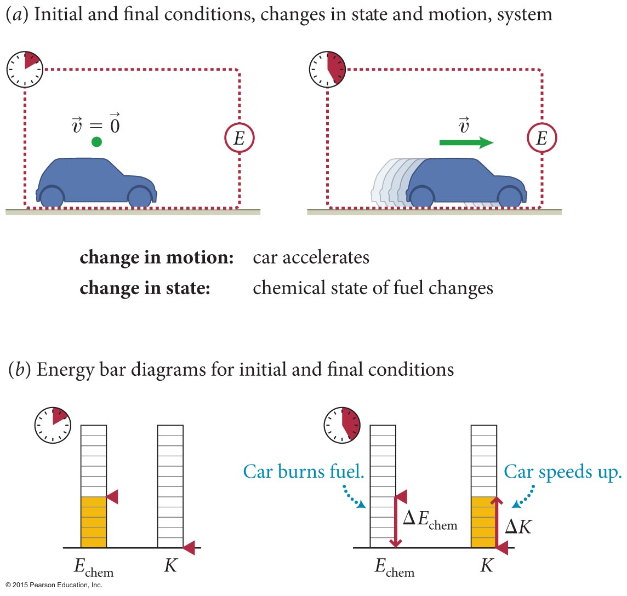
Section 5.4: Closed systems
Another example is illustrated in the figure below:
  Chemical energy stored in the gasoline is converted to kinetic energy of the car.

Slide 43
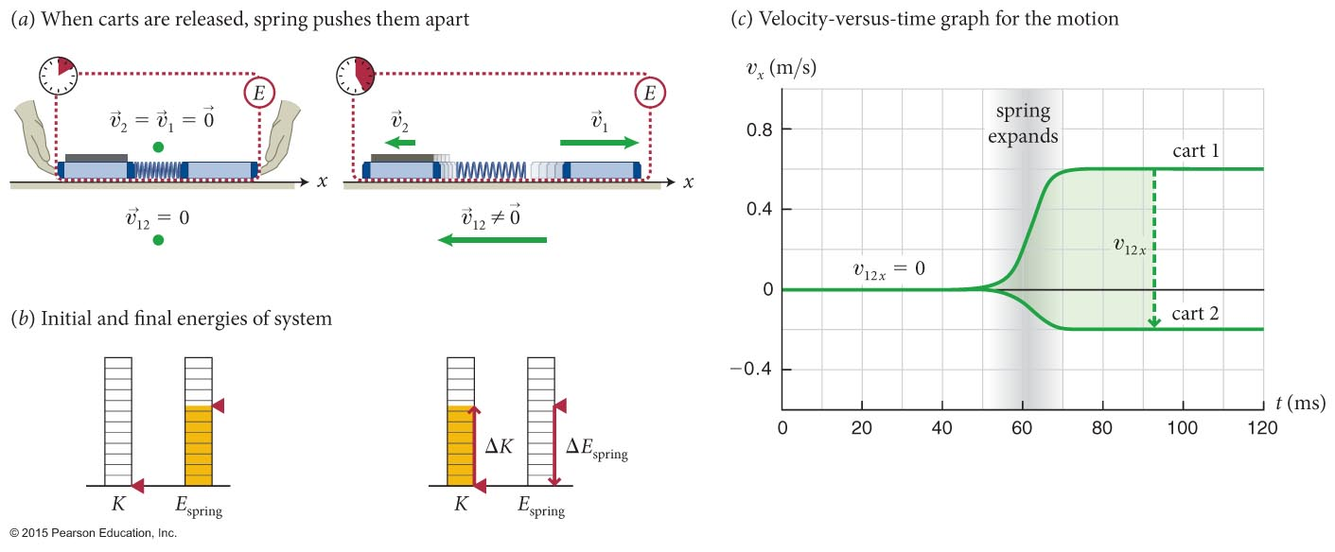
Section 5.8: Explosive separations
The figure below shows an explosive separation involving two carts.
  Because υ_{1x,i} = υ_{2x,i} = 0, using conservation of momentum we can write
  0 = m₁υ_{1x,f} + m₂υ_{2x,f}
  Applying energy conservation we get

Slide 44
Concepts: Kinetic energy
Chapter 5: Summary
The kinetic energy of an object is the energy associated with its motion.
Kinetic energy is a positive scalar quantity and is independent of the direction of motion.

Slide 45
Quantitative Tools: Kinetic energy
Chapter 5: Summary
The kinetic energy K of an object of inertia m moving at speed υ is
The SI unit of kinetic energy is the joule (J):
1 J = 1 kg · m²/s².

Slide 46
Concepts: Relative velocity, states, and internal energy
Chapter 5: Summary
In a collision between two objects, the velocity of one object relative to the velocity of the other object is the relative velocity The magnitude of the relative velocity is the relative speed υ₁₂.
The state of an object is its condition as specified by some complete set of physical parameters. Energy associated with the object’s state but not with its motion is called the internal energy of the object.
We can consider a system of two colliding objects to be isolated during the collision. Therefore the momentum of the system remains constant during all the collisions we study.

Slide 47
Quantitative Tools: Relative velocity, states, and internal energy
Chapter 5: Summary
The relative velocity of object 2 relative to object 1 is
The relative speed υ₁₂ of object 2 relative to object 1 is the magnitude of
Because momentum is a conserved quantity, the momentum of a system remains constant during a collision:
p_{x,i} = p_{x,f}.

Slide 48
Concepts: Types of collisions
Chapter 5: Summary
The coefficient of restitution e for a collision is a positive, unitless quantity that tells how much of the initial relative speed is restored after the collision.
For an elastic collision, the relative speed is the same before and after the collision, and the coefficient of restitution is equal to 1. The collision is reversible, and the kinetic energy of the system made up of the colliding objects is constant.

Slide 49
Concepts: Types of collisions
Chapter 5: Summary
For an inelastic collision, the relative speed after the collision is less than it was before the collision. The coefficient of restitution is between 0 and 1, and the collision is irreversible. The kinetic energy of the objects changes during the collision, but the energy of the system does not change. If the objects stick together, the final relative speed is zero; the collision is totally inelastic, and the coefficient of restitution is 0.
For an explosive separation, kinetic energy is gained during the collision and the coefficient of restitution is greater than 1.

Slide 50
Quantitative Tools: Types of collisions
Chapter 5: Summary
The coefficient of restitution e is
For an elastic collision,
υ_{12i} = υ_{12f}
K_{i} = K_{f}
e = 1.
For an inelastic collision,
υ_{12f} < υ_{12i}
K_{f} < K_{i}
0 < e < 1.

Slide 51
Quantitative Tools: Types of collisions
Chapter 5: Summary
For a totally inelastic collision,
υ_{12f} = 0
e = 0.
For an explosive separation,
υ_{12f} > υ_{12i}
K_{f} > K_{i}
e > 1.

Slide 52
Concepts: Conservation of energy
Chapter 5: Summary
The energy of any system is the sum of the kinetic energies and internal energies of all the objects that make up the system.
The law of conservation of energy states that energy can be transferred from one object to another or converted from one form to another, but it cannot be destroyed or created.
A closed system is one in which no energy is transferred in or out. The energy of such a system remains constant.

Slide 53
Quantitative Tools: Conservation of energy
Chapter 5: Summary
The energy of a system is
E = K + E_{int}.
The law of conversation of energy requires the energy of a closed system to be constant:
E_{i} = E_{f}.

